Slide 1

Crime Association Analysis in KPK, Pakistan: A Comprehensive Exploration
Zahoor Ahmed
Co-author: Dr. Saima Gul

Slide 2
Presentation Overview
Introduction
Problem Statement
Literature Review
Methodology
Results & Discussion
Conclusion
Crime Association Analysis in KPK, Pakistan: A Comprehensive Exploration

Slide 3
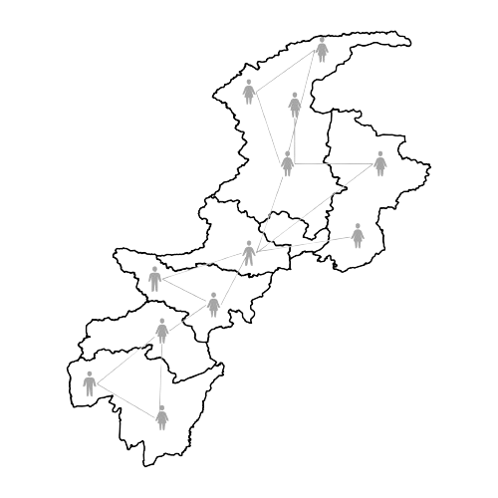
Introduction
Ensuring safety and peace is vital for societal progress
KPK emerged as a tourism destination, attracting 16 million visitors in 2023, generating Rs. 28bn annually
Inflation, unemployment, and global trends fuel crime escalation, challenging law enforcement efforts
Our study focuses on analyzing crime associations in KPK through Association Rule Mining techniques
Crime Association Analysis in KPK, Pakistan: A Comprehensive Exploration

Slide 4
Problem Statement
Analyzing multifaceted crime data requires careful consideration of various factors
Limited related research and applied methodologies
Implementation and limitations of association rule mining algorithm: Apriori
Interpretation of findings within the context of social, economic, and cultural dynamics unique to KPK
Crime Association Analysis in KPK, Pakistan: A Comprehensive Exploration

Slide 5
Literature Review
San Francisco's crime records (2003-2015) [1], employing decision trees, KNN, and random forests
Utilized structured data and named entity recognition for objective identification of high murder crime rates [2]
Employed clustering and genetic algorithms for analyzing crime patterns [3]
Leveraged Geospatial Technologies for crime forecasting and control in Bhakkar district, Pakistan [4]
Deployed STNN alongside outlier-based data association methods to forecast crime hotspots and link criminal incidents [17]
1. S. Hossain, et al. Crime prediction using spatio-temporal data. In Proceedings of ICCSCS, 2020
2. S. Chakravorty, et al. Data mining techniques for analyzing murder related structured and unstructured data. AJACT, 2015
3. Rasoul Kiani et al. Analysis and prediction of crimes by clustering and classification. (IJARAI), 4(8):11, 2015.
4. M. Hussnain. Application of geospatial information system for crime analysis: A case study, 2017
5. 5Y. Zhuang et al. Crime hot spot forecasting: A recurrent model with spatial and temporal information. In Proceedings of the ICBK. 2017
Crime Association Analysis in KPK, Pakistan: A Comprehensive Exploration

Slide 6
Dataset Overview
Crime data from KPK, spanning the years 2011 to 2019
Data from 7 divisions and 25 districts
Number of cases
Population
Total area
Police stations
Employed data analysis techniques to extract meaningful insights from the dataset
Year | Reported Cases | Population (millions) | Offense/100000
2010 | 136665 | 25.34 | 539.28
2011 | 145856 | 26.057 | 559.75
2012 | 147807 | 26.79 | 551.68
2013 | 142757 | 27.547 | 518.23
2014 | 137812 | 28.327 | 486.5
2015 | 152136 | 29.126 | 522.33
2016 | 133383 | 29.126 | 457.9
2017 | 97794 | 30.523 | 320.39
2018 | 100,250 | 35.545 | 282.19
2019 | 104,845 | 37.14 | 282.25
Source: Crimes Branch, Central Police Office, Peshawar
Crime Association Analysis in KPK, Pakistan: A Comprehensive Exploration

Slide 7
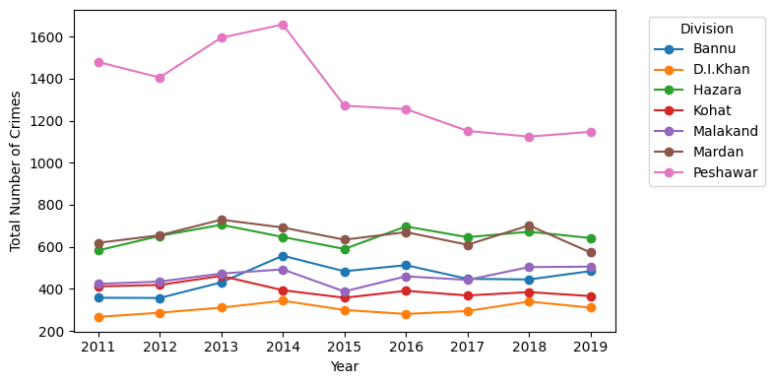
Number of crimes in each division
Number of crimes in each division, Descending order
Peshawar
Hazara
Mardan
Malakand
Bannu
Kohat
D.I.Khan
Crime Association Analysis in KPK, Pakistan: A Comprehensive Exploration

Slide 8
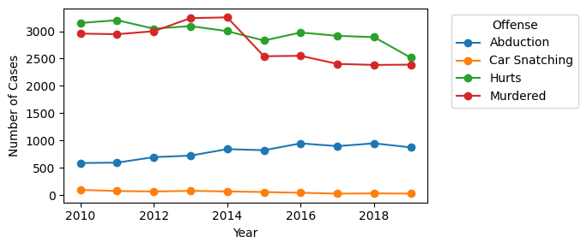
Common types of crimes in KPK
Murder and Hurt remained the main crime types throughout the years
Crime Association Analysis in KPK, Pakistan: A Comprehensive Exploration

Slide 9
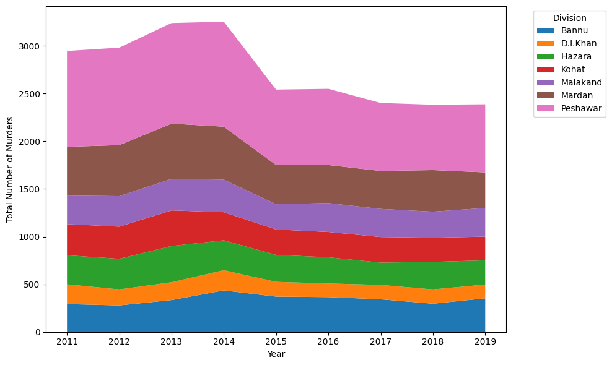
Exploring Crime Type: Murder
Peshawar division remained the high zone for murder over the years
Exploration of Peshawar division
Peshawar
Nowshera
Charsadda
Crime Association Analysis in KPK, Pakistan: A Comprehensive Exploration

Slide 10
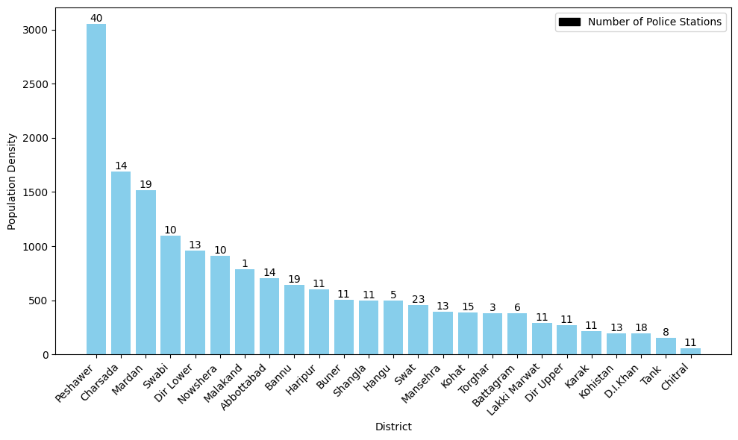
Number of Police Stations Per District
Conventional approach:
Higher population density requires more police stations
The approach contradicts when examining case numbers in Peshawar division
Crime Association Analysis in KPK, Pakistan: A Comprehensive Exploration

Slide 11
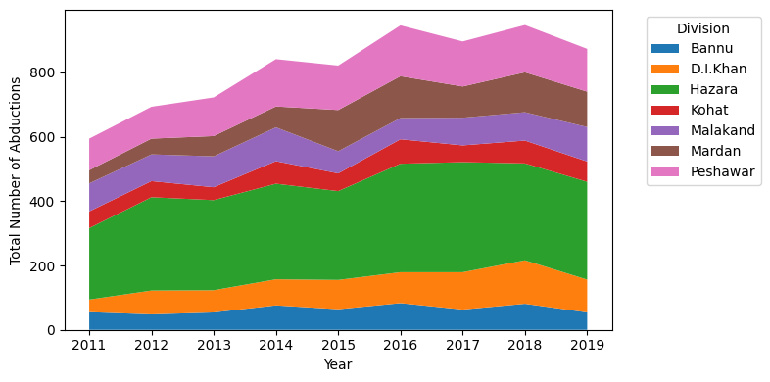
Exploring Crime Type: Abduction
Hazara division has consistently experienced a high incidence of abductions over the years.
Hazara division is the tourism hub spot in KPK (KPK Tourism dept., 2023
Crime Association Analysis in KPK, Pakistan: A Comprehensive Exploration

Slide 12
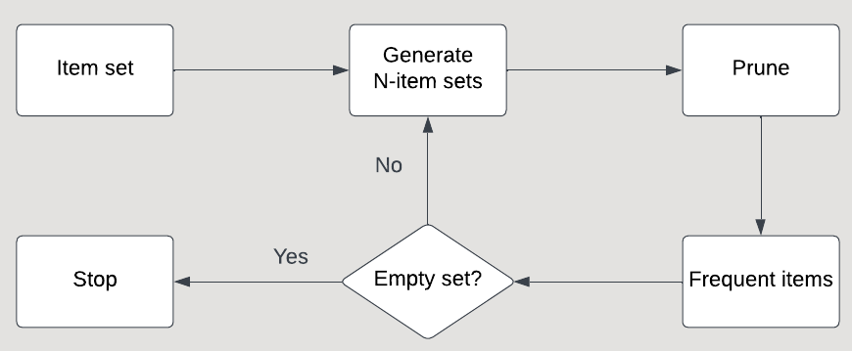
Methodology
Association Rule Mining using Apriori algorithm
Crime Association Analysis in KPK, Pakistan: A Comprehensive Exploration

Slide 13
Important metrics to understand ARM
Support: This measure gives an idea of how frequent an itemset is in all the transactions
Confidence: gives conditional probability of occurrence of consequent given the antecedent
Lift: It is the rise in probability of having {Y} on the cart with the knowledge of {X} being present over the probability of having {Y} on the cart without any knowledge about presence of {X}.
Crime Association Analysis in KPK, Pakistan: A Comprehensive Exploration

Slide 14
Results
The presented item sets exhibit significant associations compared to others, as per specified metrics
Number of Association Rules | Item sets | Support | Confidence | Lift
1931 | Abduction, Car Snatching | >80% | >80% | 1.003
1931 | Abduction, Car Theft | >80% | >80% | 1.003
Crime Association Analysis in KPK, Pakistan: A Comprehensive Exploration

Slide 15
Results (Cont.)
High support and confidence values indicate robust associations between crime types
Hints at crime interconnections, guiding targeted surveillance and prevention
Prioritize resource allocation based on high-crime associations
Crime association analysis insights inform policy and decision-making
Crime Association Analysis in KPK, Pakistan: A Comprehensive Exploration

Slide 16
Conclusion
Our study emphasizes the associations between various crime types in KPK, stressing evidence-based decision-making in law enforcement
Insights from the analysis can contribute to enhancing safety standards and reducing crime rates in the region
exploring underlying factors driving crime associations and ongoing data collection and analysis could propel the research forward
Crime Association Analysis in KPK, Pakistan: A Comprehensive Exploration

Slide 17
Thank you!
Dr. Saima Gul : saima.gul@buitms.edu.pk
Zahoor Ahmed : zachakzai@acm.org
Crime Association Analysis in KPK, Pakistan: A Comprehensive Exploration

